Slide 1
Week 6 Report
Qi Luo, Sidharth Suravarapu
OSHKOSH PROJECT: Assessment of Autonomous Driving Software Performance on Edge Devices

Slide 2
Primary Objectives
1
Implement Autoware on Ambarella edge device
2
Evaluate the capability of the Ambarella devices
3
Compare the performance of Ambarella device to the NVIDIA ORIN

Slide 3
Completed Tasks
Reviewed the newly generated documentations
Ran Benchmarks on Beetle Demo to verify NVP, GVP Usage - Using Cooper Home
Notes:
Can we run Autoware on Ambrella native system directly?
How do the stack compare to Nvidia Jetson.

Slide 4
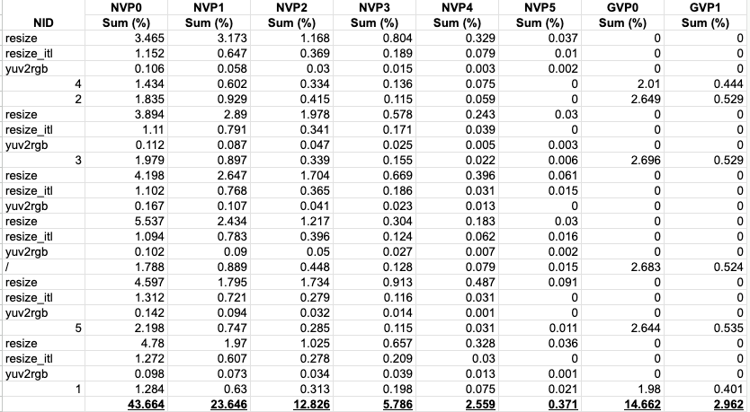
Beetle Demo: Benchmarking Results for N1
Results show slightly improved performance from Ambarella-provided documentation
LINK: https://docs.google.com/spreadsheets/d/1CO8MaR8qaK6ZJHWardiuMNDysWMEI98H/edit?gid=561081422#gid=561081422

Slide 5
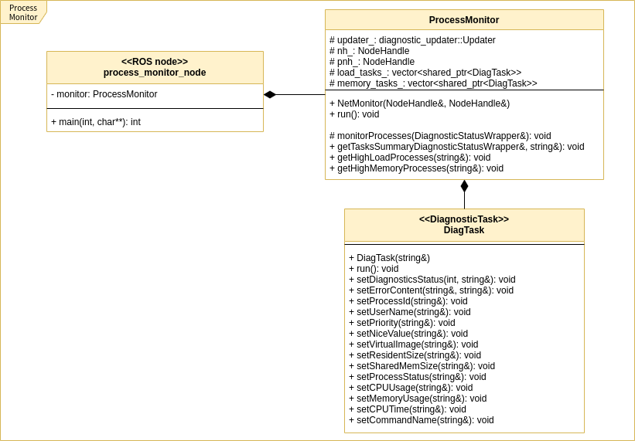
Review: Hardware Monitoring
System Monitor
Publishes topics for various hardware parameters:
CPU Monitor
HDD Monitor
Memory Monitor
Network Monitor
NTP Monitor
Process Monitor
GPU Monitor
Voltage Monitor
Example: Class Diagram for Process Monitor
https://autowarefoundation.github.io/autoware.universe/latest/system/system_monitor/

Slide 6
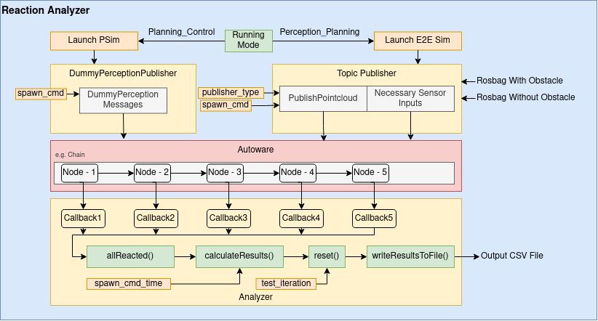
Review: Node Benchmarking
Reaction Analyzer
Subscribes to predetermined topics
Reports Node Latency, Pipeline Latency, and Total Latency for each of the nodes
https://github.com/autowarefoundation/autoware.universe/tree/main/tools/reaction_analyzer

Slide 7
Ongoing Tasks
System logging script (Uses System Monitor to publish topics, then script logs topics)
Using Reaction Analyzer: compatibility issues with current Autoware version, planning simulation
Future:
Verify inference performance with CVFlow - converted model

Slide 8
Taking Full Advantage of Ambarella
Using another PC to run Rviz together with N1, and remove the Rviz in the final product.
How?
There is also 3 other clusters that can run more tasks(each cluster has 4 arm cores), the current Lychee is only running on 1 cluster, and the other 3 clusters are running default Cooper SDK firmware, you can connect other clusters using socket, each cluster has their own IP address”

Slide 9
Questions for Ambarella

